Slide 1
12 JULY 2025
Entity Framework Core
Mahmoud Ahmed

Slide 2



EFCore ?
Entity Framework is a ORM (Object Relational Mapper)
ORM
Objects
Database
Notes:
An Object-Relational Mapper (ORM) is a programming tool that helps you interact with a relational database (like SQL Server, MySQL, PostgreSQL) using objects and classes instead of raw SQL queries.

Slide 3



Types of Mapping
Code First
ORM
Objects
Database
Database First
ORM
Database
Objects
Notes:
Code First: You write your C# classes (models) first, and Entity Framework will generate the database for you. Database First: You already have a SQL database, and you want EF to generate C# classes based on the existing tables.

Slide 4
NuGet Packages
1-Microsft.EntityFrameworkCore
2-Microsft.EntityFrameworkCore.Tools
3-Microsft.EntityFrameworkCore.SqlServer
Notes:
NuGet packages are reusable libraries or tools that you can add to your .NET project to save time and avoid writing common code from scratch.

Slide 5
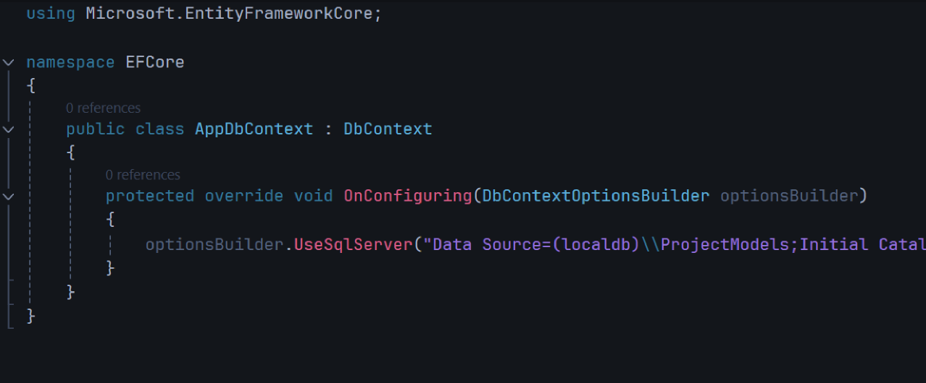
DbContext
DbContext is the main class in Entity Framework that acts like a bridge between your C# code and the database.
Notes:
A connection string tells EF how to connect to your database: What server to use What database name What username/password (or use Windows Auth)

Slide 6
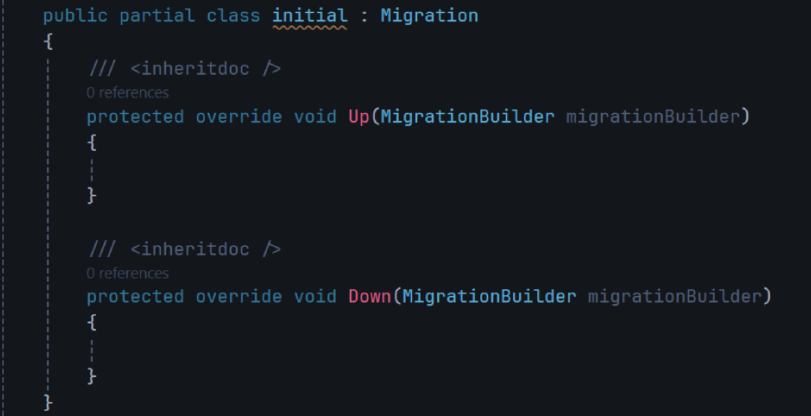
Migration
A migration is a way to update the database schema (tables, columns, relationships, etc.) from your C# code — automatically.

Slide 7
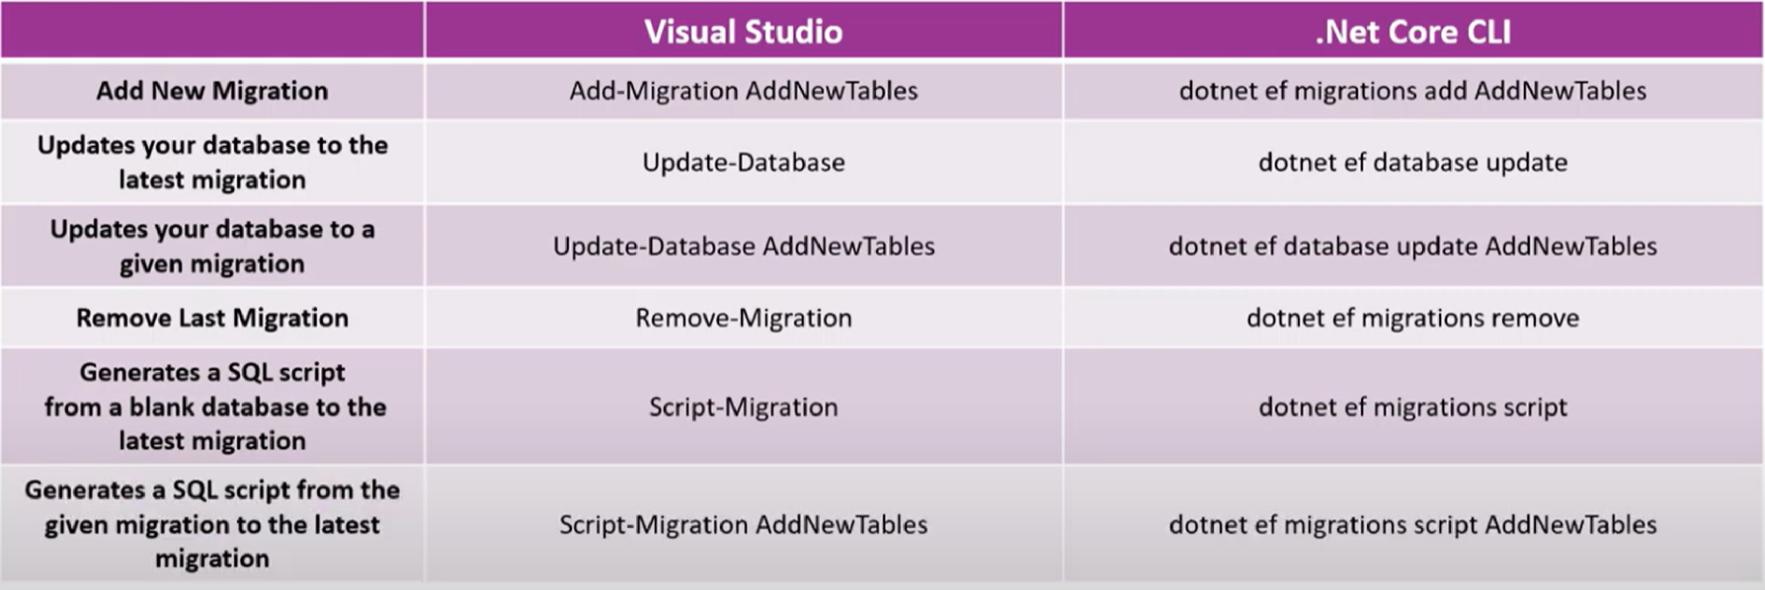

Slide 8
In EF Core, every migration class contains two methods:
Up( ): Apply changes to the database (e.g., create table, add column)
Down( ): Undo those changes (e.g., drop table, remove column)

Slide 9
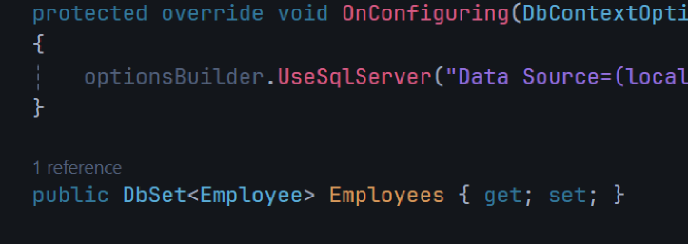
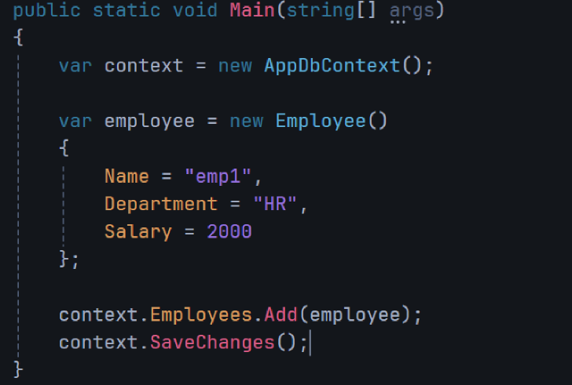
Add Table, Record
Add the Table to the DbContext Class
Add New Data to the Table

Slide 10
Model Configuration
Data Annotations: C# attributes added directly to your model class properties to define how they map to database columns
Fluent API: code-based configuration method used inside the OnModelCreating() method of the DbContext class to define relationships, constraints, and mapping rules for database tables.

Slide 11
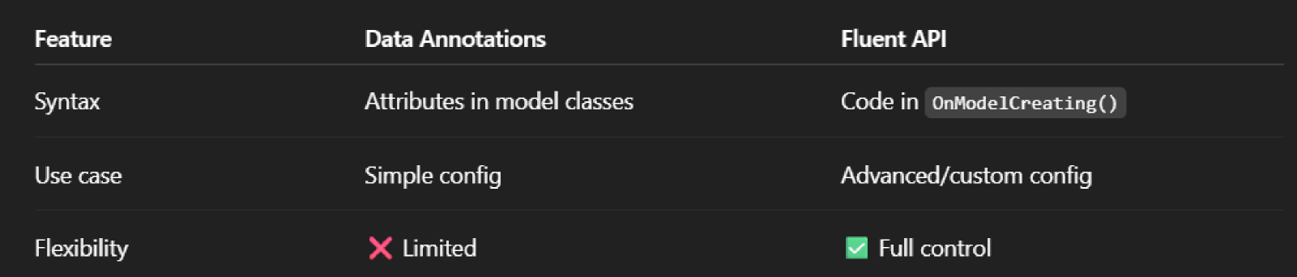
Fluent API vs Data Annotations

Slide 12
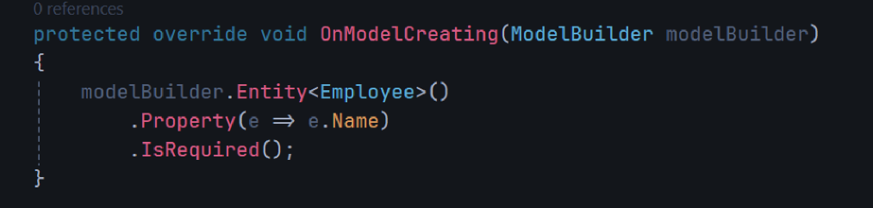
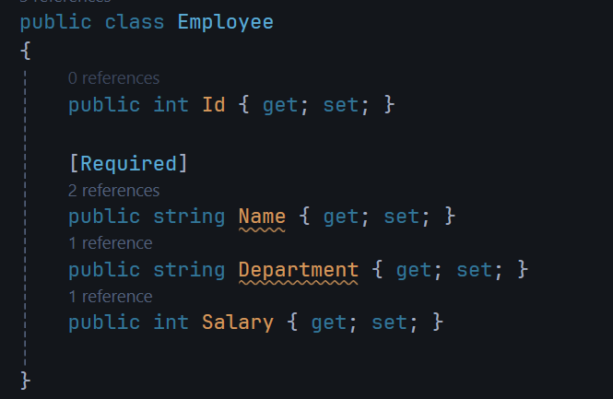
Fluent API
Data Annotations

Slide 13
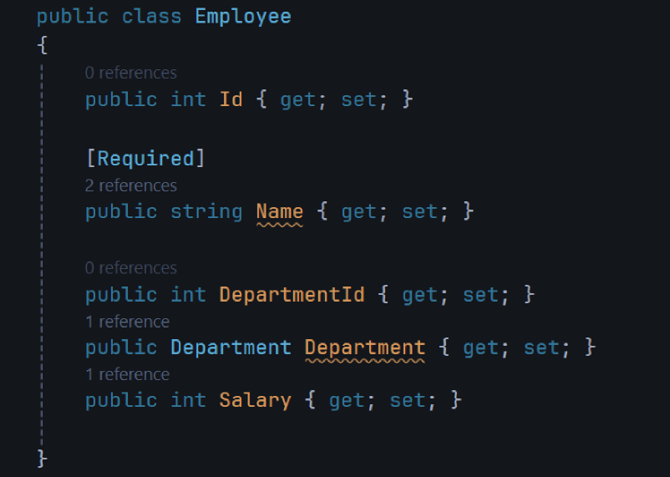
Navigation Property
A navigation property is a property in your model class that represents a relationship to another table (another class).

Slide 14
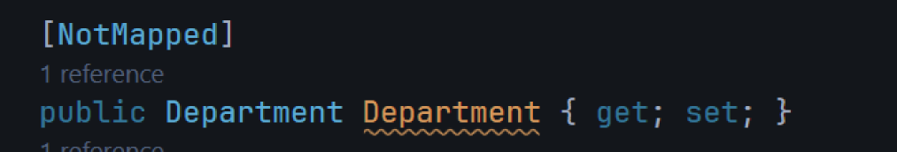


Exclude Entity From Model
Data Annotations
Fluent API
Execlude Property

Slide 15
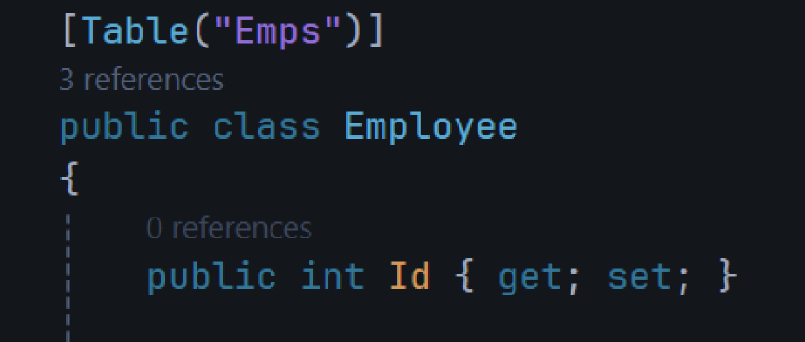
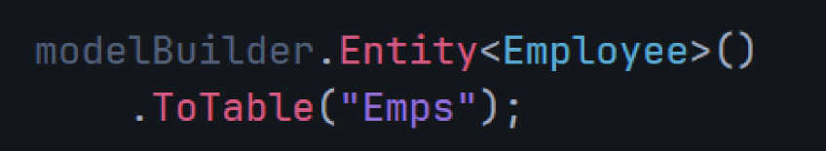
Change Table Name
Data Annotations
Fluent API

Slide 16

Hands-On #1
1-Download NuGet Packages
2-Add AppDbContext Class and ConnectionString
3-Add Books Table With Navigation Property to Authors Table
4-Change Authors Table to Name Writers
Note: Use Fluent API, Add Migrations and Update Database

Slide 17
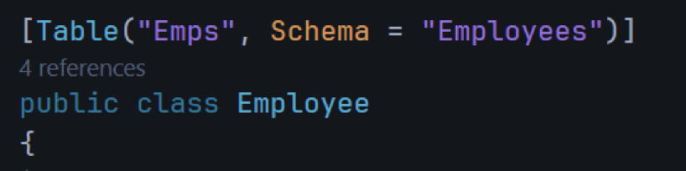

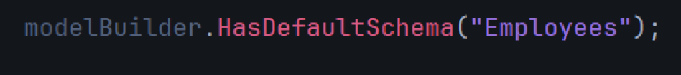
Change Schema
Data Annotations
Fluent API
Notes:
In Entity Framework, a schema is a logical container or namespace inside the database that groups database objects like tables, views, and procedures.

Slide 18
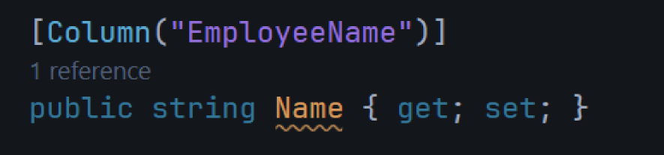
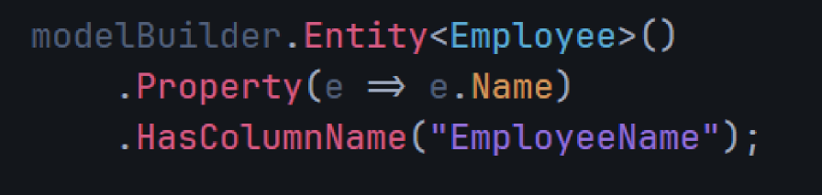
Change Column Name
Data Annotations
Fluent API

Slide 19
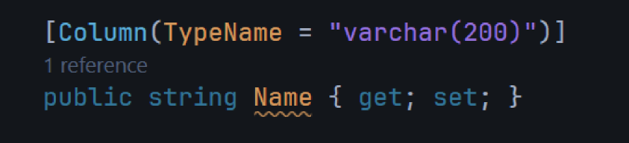
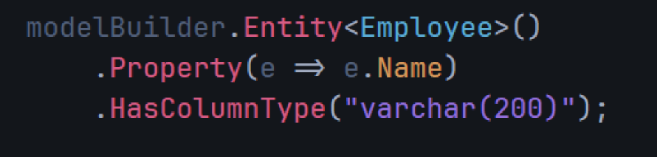
Change Column Data Type
Data Annotations
Fluent API

Slide 20
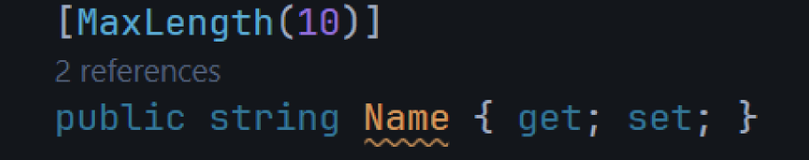
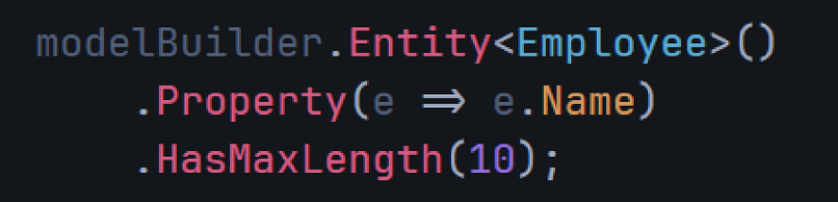
Set Property Max Length
Data Annotations
Fluent API

Slide 21
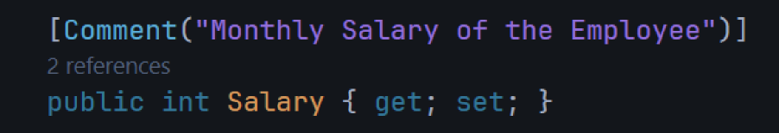
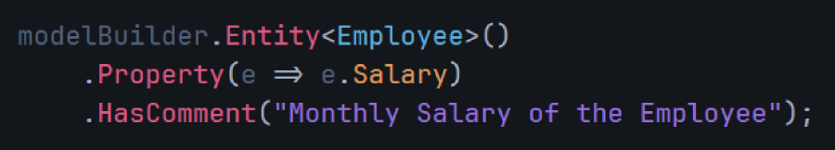
Set Column Comment
Data Annotations
Fluent API

Slide 22
Primary Key
A Primary Key is a column (or set of columns) in a database table that uniquely identifies each row.
EFCore automatically set primary key if property name
1-Id
2-{Classname} + Id
A Primary Key has Identity (auto-generated value) if it has data type int, long only.

Slide 23
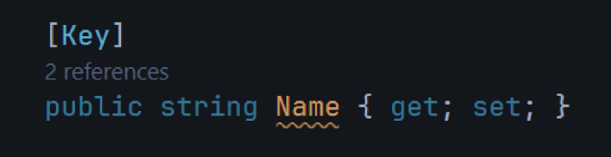
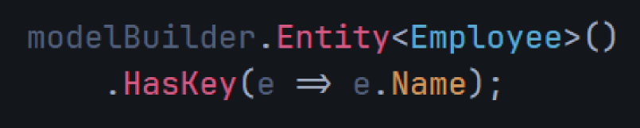
Change Primary Key
Data Annotations
Fluent API

Slide 24
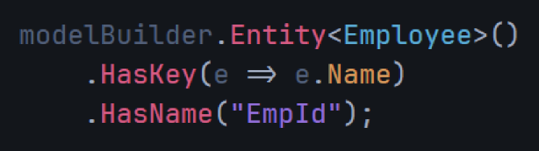
Change Primary Key Name
Cannot be done with Data Annotations
Fluent API

Slide 25
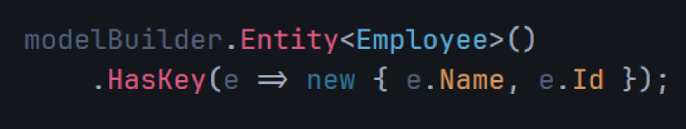
Composite Key
A composite key is a primary key made up of two or more columns that together uniquely identify a row in a table.
Cannot be done with Data Annotations
Fluent API

Slide 26
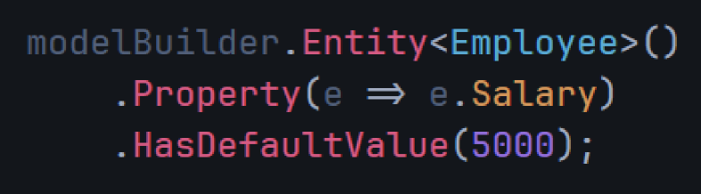
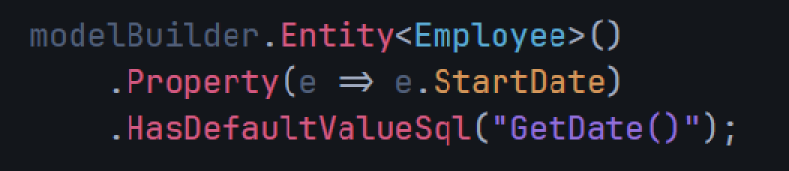
Set Default Value
Cannot be done with Data Annotations
Fluent API
Using Sql Statement

Slide 27
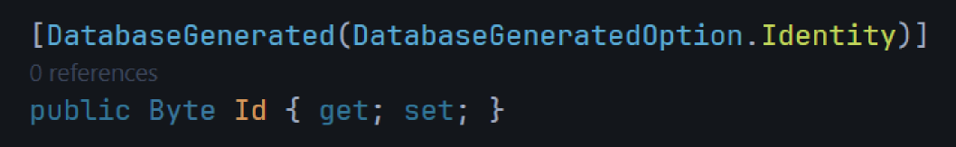
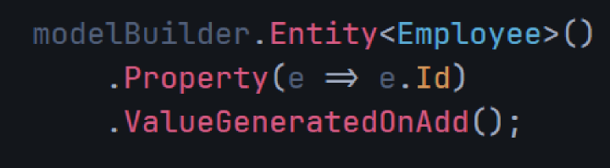
Set Identity for Keys with data type that is not int, long (set auto-generated value)
Data Annotations
Fluent API

Slide 28

Hands-On #2
1-Change Default Schema to “OSC”
2-Change Name Column to “Title”
3-Set Composite Key Name + Id
4-Set Default Value for Price Column
Note: Use Fluent API, Add Migrations and Update Database

Slide 29
Relationships
One to one relationship
has
Person
1
1
Passport

Slide 30
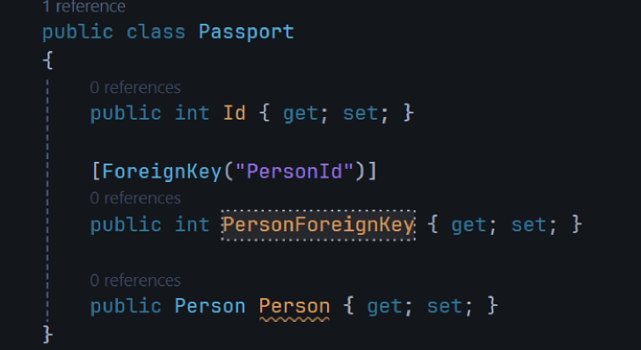
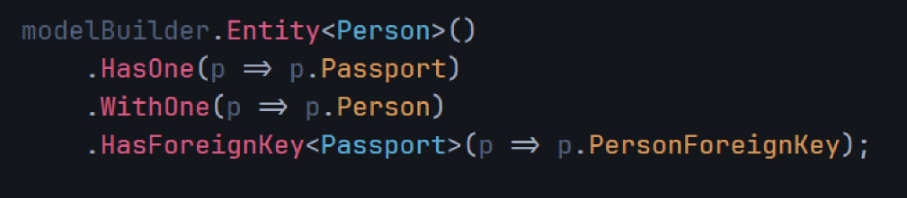
One to one relationship
Data Annotations
Fluent API

Slide 31
One to many relationship
Works in
Employee
M
1
Department

Slide 32
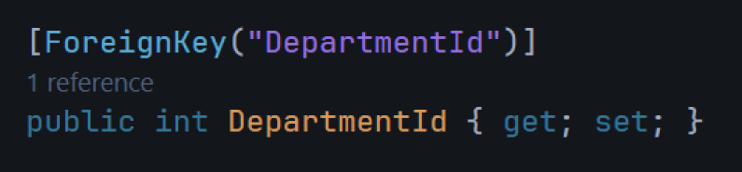
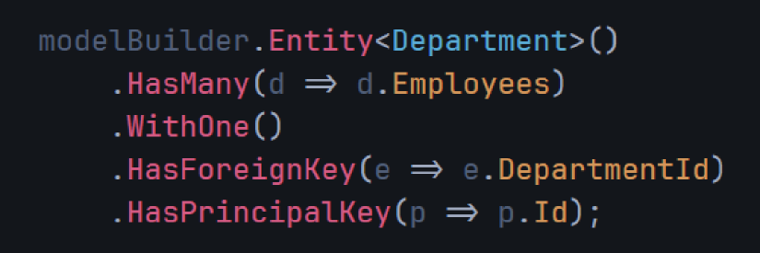
One to many relationship
Data Annotations
Fluent API

Slide 33
Many to many relationship
Acts in
Cast
M
M
Movie

Slide 34
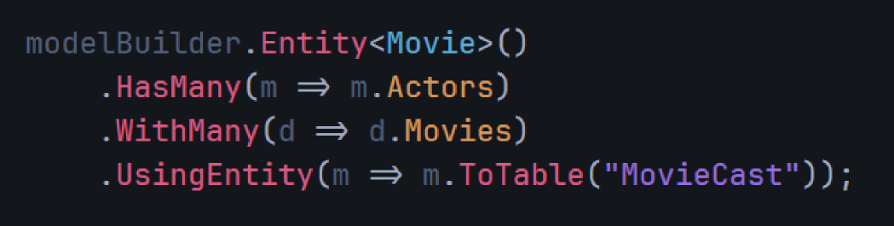
Many to many relationship
Fluent API

Slide 35
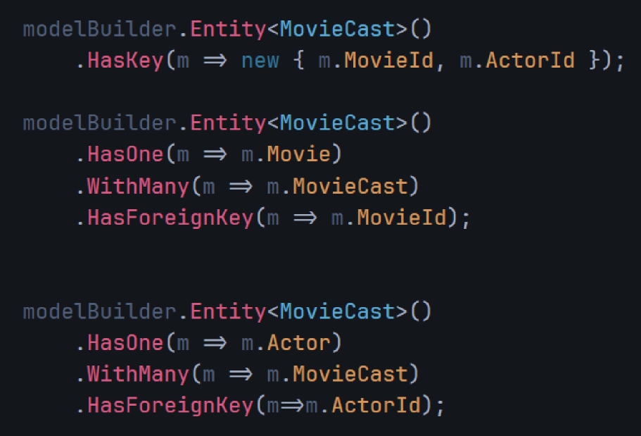
Many to many relationship Using Entity
Fluent API

Slide 36
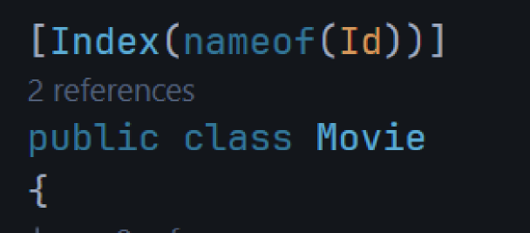
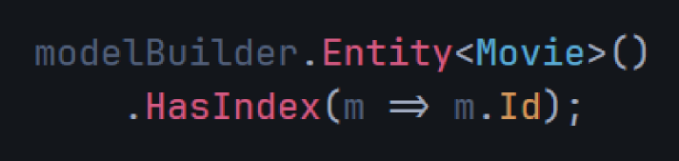
Index
An index is a special data structure that helps the database find rows faster, just like an index in a book.
Data Annotations
Fluent API

Slide 37
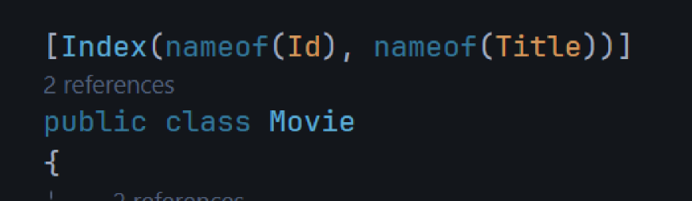
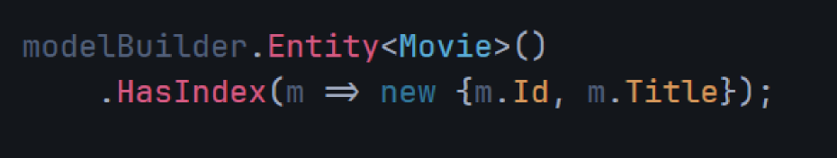
Composite Index
Data Annotations
Fluent API

Slide 38
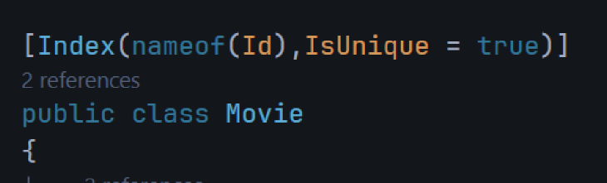
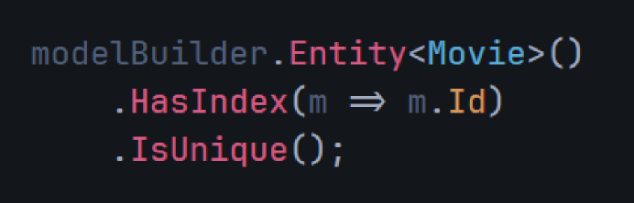
Index Uniqeness
A unique index enforces that all values in the indexed column(s) must be different — no duplicates allowed.
Data Annotations
Fluent API

Slide 39
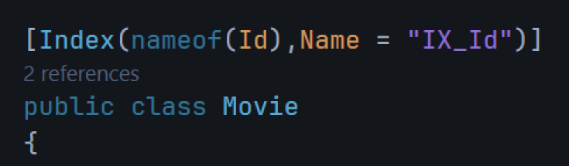
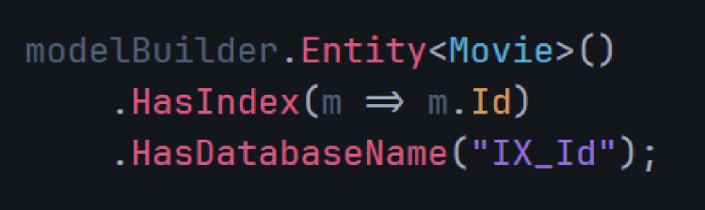
Change Index Name
Data Annotations
Fluent API

Slide 40
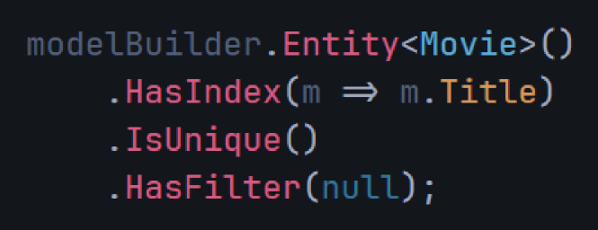
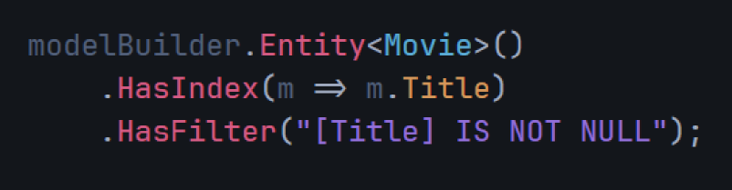
Index Filter
A filtered index (or partial index) only applies to rows that match a condition.
Cannot be done with Data Annotations
Fluent API

Slide 41

Hands-On #3
1-Add One to Many Relationship Between Book and Authors
2-Add Index to Book Id Column
3-Make Filter to Index (IS NOT NULL)
Note: Use Fluent API, Add Migrations and Update Database

Slide 42
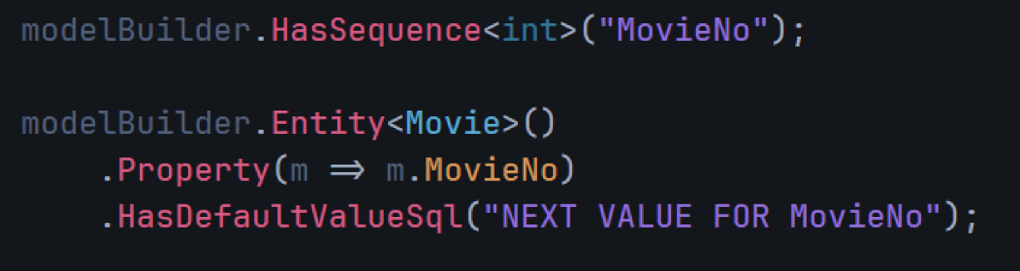
Sequence
A sequence is a database object that generates a series of unique numbers, often used to assign IDs.

Slide 43
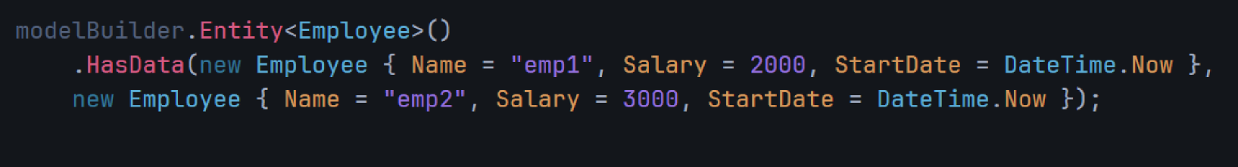
Data Seeding
Inserting initial data into your database automatically when you run a migration or create the database.

Slide 44
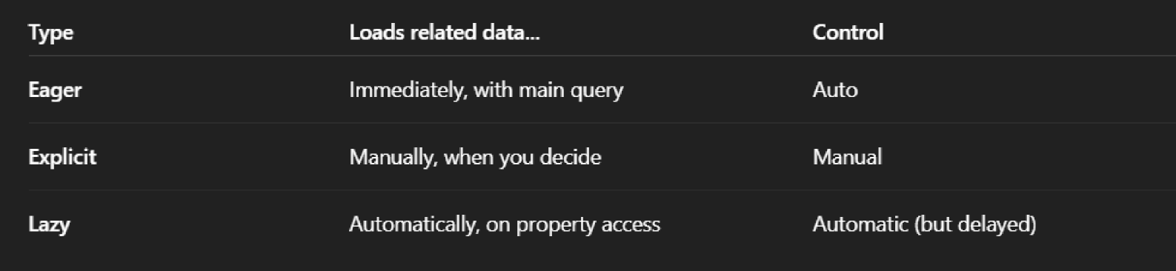
Loading Strategies
When you query an entity (like Department), and it has related entities (like Order.Employees), you need to decide how and when to load those related entities.
EF Core gives you three ways:

Slide 45
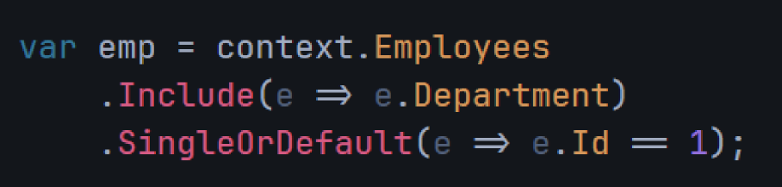
Eager Loading
Loads the related data as part of the initial query.

Slide 46


Explicit Loading
Load the related data manually, after the main query.
For Collection

Slide 47
Lazy Loading
EF Core automatically loads the related data the moment you access the property.
To Use Lazy Loading You Should Install NuGet Package:
Microsoft.EntityFrameworkCore.Proxies

Slide 48


Lazy Loading
DbContext

Slide 49
Thank You <3

